Slide 1
COMP 2560 System Programming: Sockets: examples
Content
Courtesy of Dr. B. Boufama
modified by Dan Wu
School of Computer Science University of Windsor
–
Instructor: Dr. Abed Alkhateeb

Slide 2
Content
Content
1
Socket based client/server IPC
2
IP addresses and port numbers Port numbers
IP addresses
3
Examples: implementation of client/server applications Example 1: the server handles each client
Example 2: the server creates a child process for each client

Slide 3
Socket based client/server IPC IP addresses and port numbers
Examples: implementation of client/server applications
Sockets: typical scenario
Server
create end−point
socket()
bind address
bind()
Client
specify queue
listen()
socket()
wait
accept()
connect()
read/write
read/write
exchange message
close()

Slide 4
Socket based client/server IPC IP addresses and port numbers
Examples: implementation of client/server applications
Port numbers IP addresses
Port numbers
Port Numbers: Port numbers are 16 bit numbers used by TCP and UDP to identify different applications.
Three kinds of port numbers:
1
Well known ports: are those number from 0 - 1023. They are assigned by the IANA(Internet Assigned Numbers Authority), only be used by system processes. ftp server uses port 21, telnet server uses port 23, and web server uses port 80. Well-known port numbers are contained in file /etc/services on Unix machines.
Registered Ports: are from 1024 to 49151. They are registered by the I.A.N.A.
Dynamic and/or Private Ports: are from 49152 to 65535. Free of use.
2
3

Slide 5
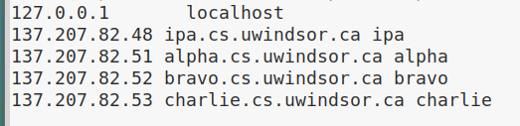
Socket based client/server IPC IP addresses and port numbers
Examples: implementation of client/server applications
Port numbers IP addresses
IP addresses
Each machine on the internet has a unique Internet Address(IP address). The address is made of 32 bit number, and normally written as four decimal numbers.
E.g. arc1 : 137.207.32.27
the command /usr/sbin/nslookup allows to get the IP address of a machine given its name (and vide versa).

Slide 6
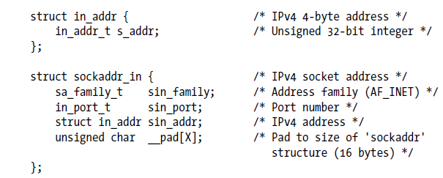
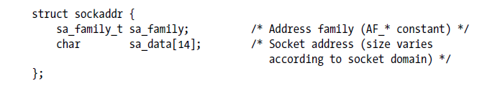
Socket based client/server IPC IP addresses and port numbers
Examples: implementation of client/server applications
Port numbers IP addresses
IP addresses
Remember casting?
Cast sockadd_in type to sockaddr type when…..?

Slide 7
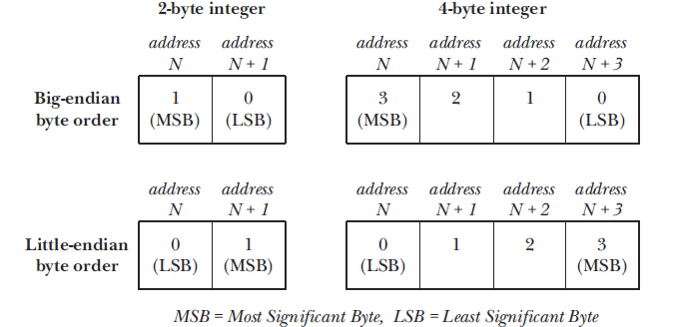
Socket based client/server IPC IP addresses and port numbers
Examples: implementation of client/server applications
Port numbers IP addresses
IP addresses and Port numbers
IP addresses and port numbers are integer values.
One problem we encounter when passing these values across
a network is that different hardware architectures store the bytes of a
multibyte integer in different orders.
The byte ordering used on a particular machine is called the host byte order

Slide 8
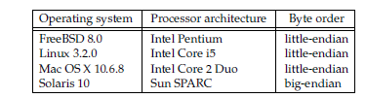
Socket based client/server IPC IP addresses and port numbers
Examples: implementation of client/server applications
Port numbers IP addresses
IP addresses and Port numbers
Since port numbers and IP addresses must be transmitted
between, and understood by, all hosts on a network, a standard
ordering must be used. This ordering is called network byte order,
and happens to be big endian.
lscpu | grep "Byte Order"

Slide 9
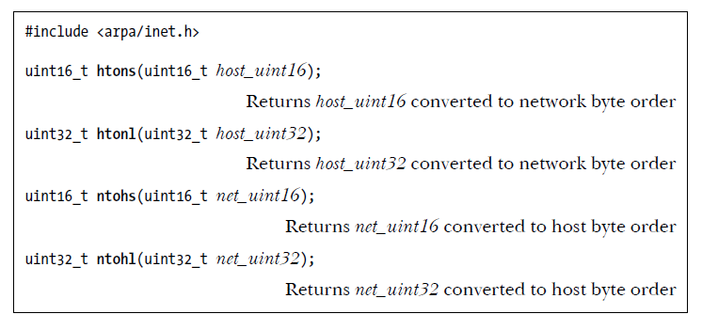
Socket based client/server IPC IP addresses and port numbers
Examples: implementation of client/server applications
Port numbers IP addresses
IP addresses and Port numbers
.

Slide 10
Socket based client/server IPC IP addresses and port numbers
Examples: implementation of client/server applications
Example 1: the server handles each client
Example 2: the server creates a child process for each client
Example 1: Server
int main(int argc, char *argv[]){
char buffer[100] = "Hello, here is my message\n"; int sd, client;
socklen_t len;
struct sockaddr_in servAdd; //server socket address struct sockaddr_in cliAdd; //client socket address
sd = socket(AF_INET, SOCK_STREAM, 0); servAdd.sin_family = AF_INET; servAdd.sin_addr.s_addr = INADDR_ANY;
//INADDR_ANY allows your program to work without
// knowing the IP address of the machine it was running on servAdd.sin_port = 7777; // a port number
bind(sd,(struct sockaddr*)&servAdd,sizeof(servAdd)); listen(sd, 5);
while(1){
len = sizeof(cliAdd);
client=accept(sd,(struct sockaddr*)&cliAdd, &len); write(client, buffer, strlen(buffer) + 1); close(client);
}
}
server.c/client.c

Slide 11
Socket based client/server IPC IP addresses and port numbers
Examples: implementation of client/server applications
Example 1: the server handles each client
Example 2: the server creates a child process for each client
Example 1: Client
int main(int argc, char *argv[]){ char buffer[100];
int server; socklen_t len;
struct sockaddr_in servAdd;//server socket address
server = socket(AF_INET, SOCK_STREAM, 0);
servAdd.sin_family = AF_INET; servAdd.sin_addr.s_addr = inet_addr(argv[1]);
//The inet_addr() function converts the specified string,
//in the Internet standard dot notation,
// to an integer value suitable for use as an Internet address.
servAdd.sin_port = 7777;
connect(server, (struct sockaddr *) &servAdd, sizeof(servAdd));
read(server, buffer, 100);
fprintf(stderr, "%s\n", buffer);
}

Slide 12
Socket based client/server IPC IP addresses and port numbers
Examples: implementation of client/server applications
Example 1: the server handles each client
Example 2: the server creates a child process for each client
Example 2: Server (parent process)
int main(int argc, char *argv[]){ char buffer[100];
int sd, cd; socklen_t len;
struct sockaddr_in servAdd, cliAdd;
sd = socket(AF_INET, SOCK_STREAM, 0); servAdd.sin_family = AF_INET; servAdd.sin_addr.s_addr = INADDR_ANY; servAdd.sin_port = 7777;
bind(sd,(struct sockaddr*)&servAdd,sizeof(servAdd)); listen(sd, 5);
while(1){
len = sizeof(cliAdd);
cd = accept(sd, (struct sockaddr *) &cliAdd, &len); if(fork()==0)
child(cd); close(cd);
}
}
server2.c/client2.c

Slide 13
Socket based client/server IPC IP addresses and port numbers
Examples: implementation of client/server applications
Example 1: the server handles each client
Example 2: the server creates a child process for each client
Example 2: Server (child process)
void child(int sd){ char line[255];
while(1){
fprintf(stderr, "Enter a line to send client\n"); scanf("%s", line);
write(sd, line, strlen(line)+1); if(!read(sd, line, 255)){ close(sd);
exit(0);
}
fprintf(stderr, "Client sent back: %s\n", line);
}
}

Slide 14
Socket based client/server IPC IP addresses and port numbers
Examples: implementation of client/server applications
Example 1: the server handles each client
Example 2: the server creates a child process for each client
Example 2: Client
^{int main(int argc, char} *^{argv[]){} char buffer[100];
int server; socklen_t len;
struct sockaddr_in servAdd; //server socket address
server = socket(AF_INET, SOCK_STREAM, 0);
servAdd.sin_family = AF_INET; servAdd.sin_addr.s_addr = inet_addr(argv[1]); servAdd.sin_port = 7777;
connect(server, (struct sockaddr *^{) &servAdd,} sizeof(servAdd));
while(1){
read(server, buffer, 255);
fprintf(stderr, "Server’s message: %s\n", buffer); fprintf(stderr, "Enter a line to send server\n"); scanf("%s", buffer);
if(buffer[0]==’$’){ close(server); exit(0);
}
write(server, buffer, strlen(buffer)+1);
}
}

